Slide 1
Why Oral Health Is Important For Your Pet (and for you)
Bill Gengler, DVM
Diplomate, American College of Veterinary Dentistry & Oral Surgery

Slide 2
Progression of Dental Disease
Plaque begins as a biofilm (scum)
Within 48 hours plaque will mineralize into hard calculus (tartar)
Plaque is rich in bacteria
Surface bacteria are aerobic and less harmful
Tartar protects the bacteria allowing bone destruction
Bone destruction causes deep pockets where anaerobes flourish
Anaerobic bacteria are very pathogenic
Bone is rich in blood supply
Blood supply transports pathogenic bacteria to major organs
Oral disease is a major contributor to early organ failure

Slide 3
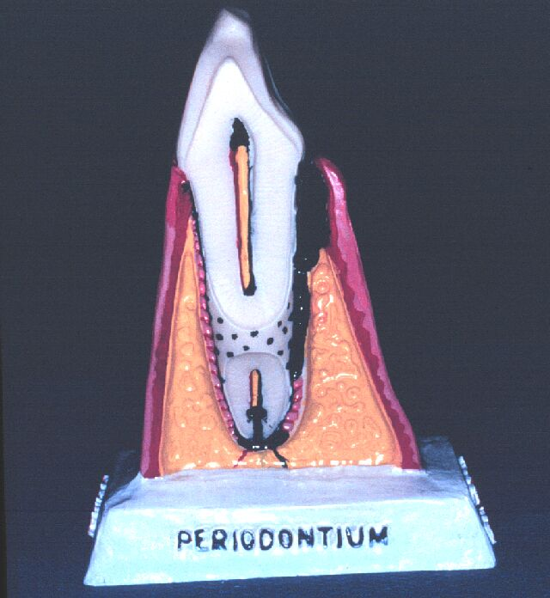
The Periodontium
Healthy Anatomy
-self cleaning
Diseased Anatomy
-disease promoting

Slide 4
Biofilm- remove before it mineralizes
Gross removal
(COHAT) comprehensive oral health assessment & treatment
The kidneys, heart and liver are the most targeted organs of oral pathogens
Home care
3. Nieves, M.A., Hartwig, P., Kinyon, J.M., Riedesel, D.H.: Bacterial isolates from plaque and from blood during and after routine dental procedures in dogs. Vet Surg 26(1): 26-32; 1997.

Slide 5
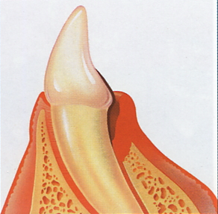
Bacteria
BACTERIA
Host Response
Arachidonic Acid
Collagenase
Toxins
Prostaglandins
Inflammation
Bone Loss
Systemic disease

Slide 6
Homecare for my Lolly!
Daily “spin” Brushing w/ an enzymatic paste
Dental diet
Tartar Shield treats
T/d treats
Milk Bone Brushing Chews
Kongs and soft toys

Slide 7
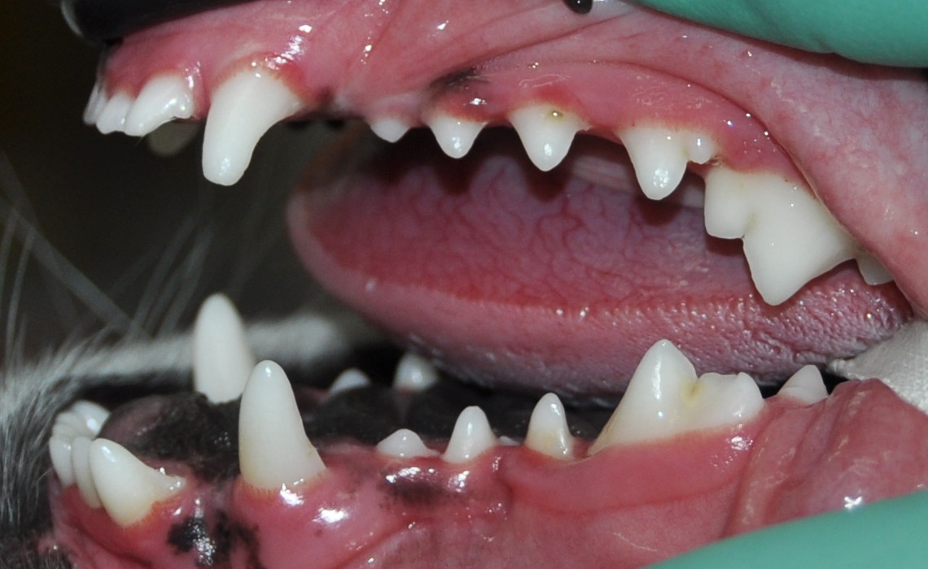
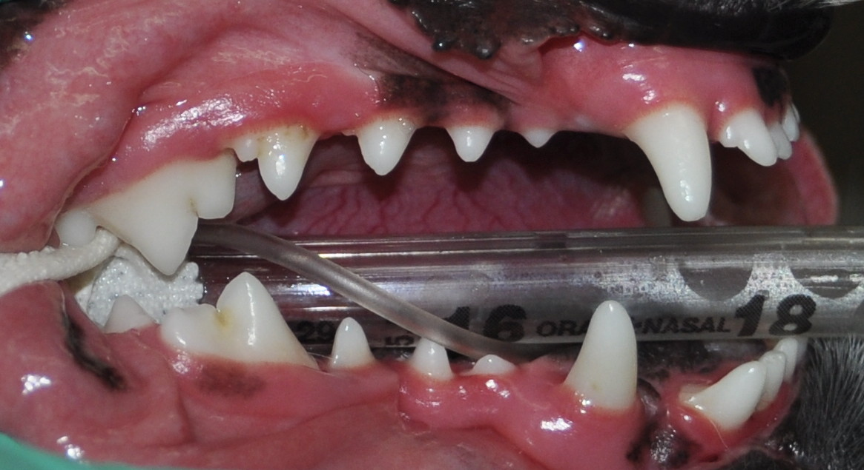
Oral Exam After 12 months (pre-cleaning)

Slide 8
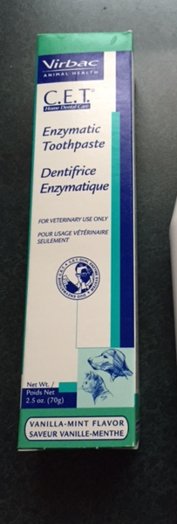
Teeth Brushing is the Gold Standard
Brush daily with an enzymatic toothpaste
Electric “Spin” Brush
Use mechanical plaque control (texture)
Diet, treats and toys
Use chemical plaque control (NaHMP)
Diet and treats
COHATs on a regular, as needed, basis

Slide 9
Think Multimodal Dental Homecare
Daily Brushing
Dental Diet
Dental Treats
Safe Chew Toys

Slide 10
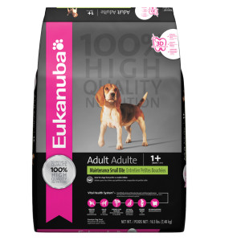
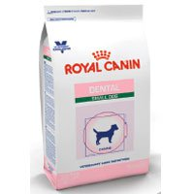
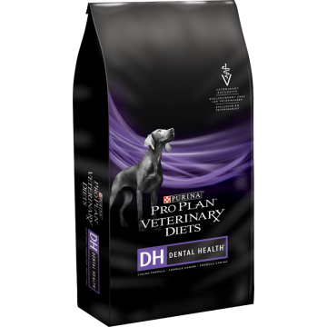
Multimodal Dental Homecare Diets – Eucanuba, Royal Canin, Purina
Calculus control
Mechanical
-abrasive biscuit
Chemical
-NaHexametaphosphate
or
-Na tripolyphosphate

Slide 11
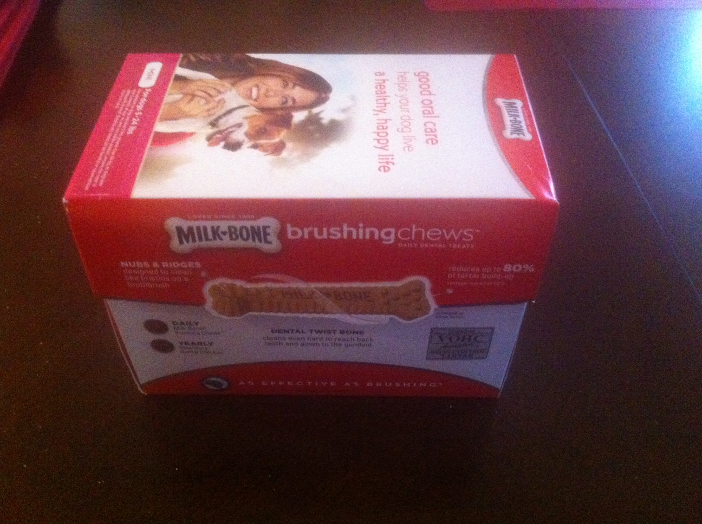
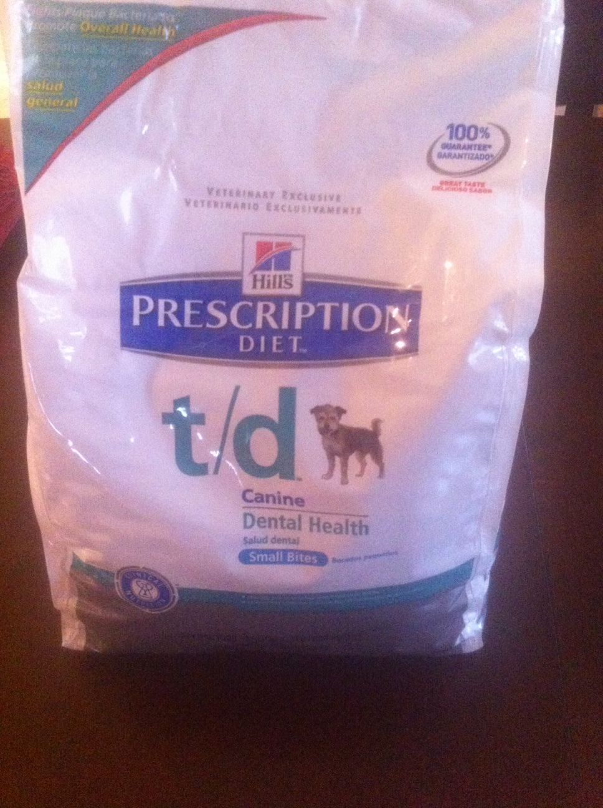
Multimodal Dental Homecare Chews or Treats

Slide 12
Safe Chew Toys
Avoid ultra hard chews such as:
1. Antlers
2. Bones
3. Beef hooves
4. Nylon bones

Slide 13
Before you purchase oral health products………
Visit this website …..VOHC.org
The Veterinary Oral Health Council sponsored by the American Veterinary Dental College
*all products listed have been tested and certified for efficacy and safety

Slide 14
But, frequent COHATs are expensive!!
Safe anesthesia is a must
The old adage: “An ounce of prevention is worth a pound
of cure”!
Consider the savings on medical expenses from early
onset of major organ disease
Consider the animals quality and length of life
Many Pet Insurance companies have policies that make
general and dental care fairly affordable

